Slide 1
Software Architecture

Slide 2
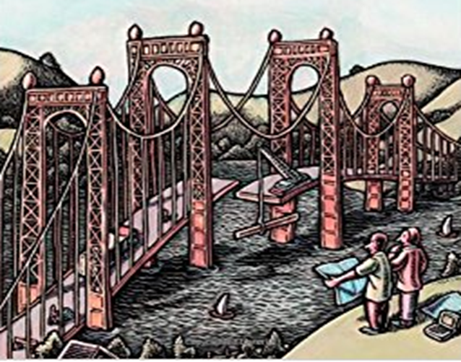
Easing in & Architectural Model

Slide 3


Easing into Architecture
Consider a very commonly used technology for talking to a remote person.
Plain old telephone
Central office hardware (PSTN switch)
Benefits
Works through power outage
Reliability
Skype
Peer to peer
Benefits
Scales without changes
Features can be added easily
Two architectural choices
Centralized versus peer to peer

Slide 4
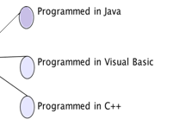

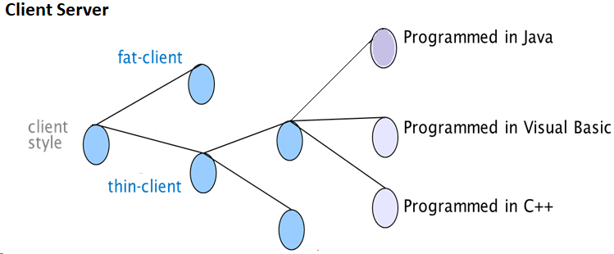
Design issues, options and decisions
A designer can face a series of design issues or problems
He / She then makes a design decision to resolve each issue
This involves choosing the best option from among the alternatives. E.g.

Slide 5
Architectural conflicts
Using large-grain components improves performance but reduces maintainability.
Introducing redundant data improves availability but makes security / data integrity more difficult.
Normalization/De-Normalization in DB
Localizing safety-related features usually means more communication so degraded performance.
……

Slide 6
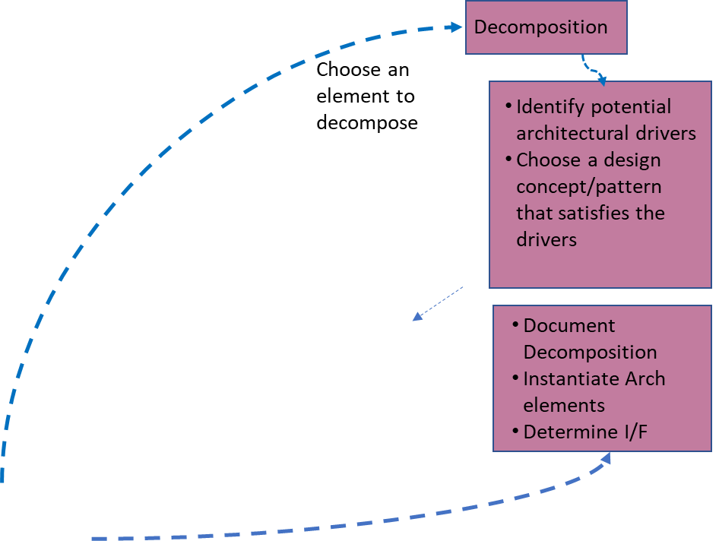
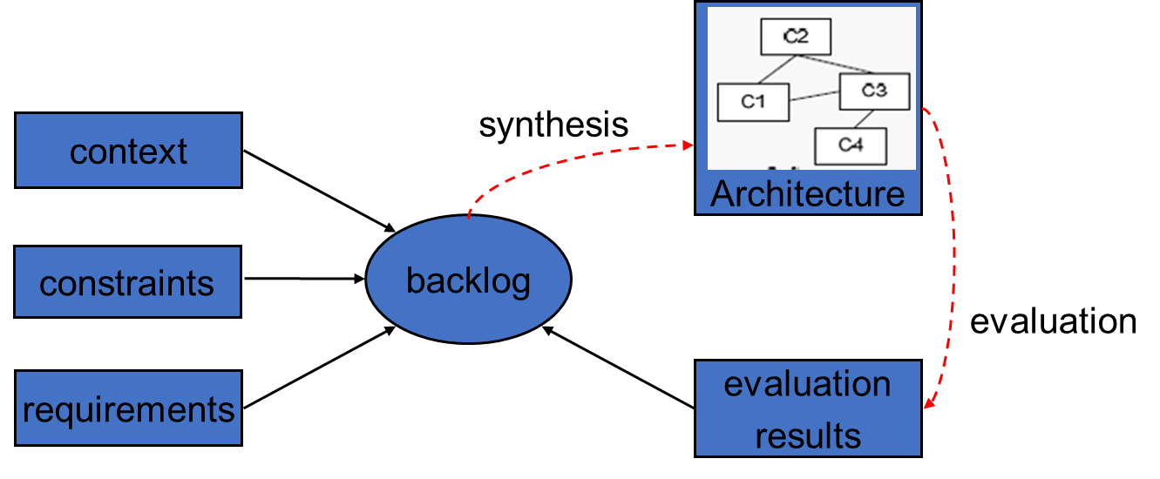
Generalized model for architecting
Understand problem
Solve it
Evaluate solution
A global workflow around architecture design, then would look as below
synthesize
evaluate

Slide 7
Decomposition

Slide 8
Decomposition approaches
Decomposition based on layering
Ordering the system to different layers
Decomposition based on Distribution among “COMPUTATIONAL RESOURCES” based on or due to system having
Dedicated task owning a thread of control and hence some processes not needing to wait for this process
Many clients needing access
Needing Greater fault isolation
Distribution for separation of concern with redundancy which allows for high availability

Slide 9
Decomposition approaches
Decomposition based on Exposure
On how the component is Exposed and consumes other components. This could be based on the components - Service offered, logic and Integration
Decomposition based on Functionality
Grouping within the problem domain and separating concerns based on the Functionality. E.g. login module, customer module, inventory module etc. Done with the mindset of an Operational process
Decomposition based on Generality
Considering Generality or trying to understand components which can be used in other places as well. (Not to overdo)

Slide 10
Decomposition Other approaches
Divide and conquer - Divide a complex problem into smaller simpler problems
Stepwise refinement - Start with a simple solution and enhance it in steps
Top-down approach - Start with an overview of the system, then detail the subsystems
Bottom-up approach - Specify individual elements in detail and then compose them together
Information hiding – E.g. Encapsulation, separation of interface from implementation

